Slide 1
Goal: User registration

Slide 2

The schema builds us a class for the document
First step:
We need to require:
Mongoose
Build a schema
Our main goal: to create a schema

Slide 3
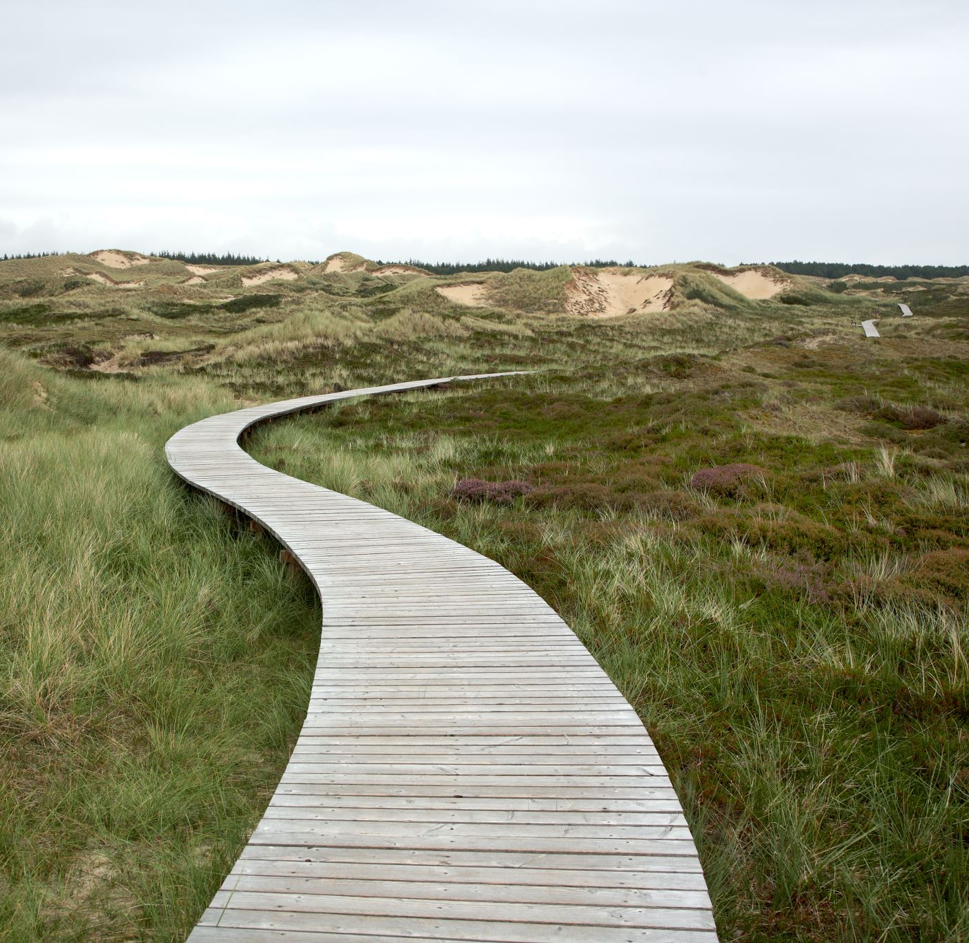
Step 3:
Endpoints
Goal of endpoint:
A port to intercept with the server/ client
Need to require the correct schema

Slide 4
VS
EJS
POSTMAN

